Slide 1
Lesson 15: UML and Design Pattern
15.1 Introduction of Design Pattern
15.2 Creational Mode
15.3 Structural Mode
15.4 Behavioral Mode

Slide 2
15.1 Introduction of Design Pattern
What is Design Pattern?
  A general reusable solution to a commonly occurring problem in software design
  A description or template for how to solve a problem that can be used in many different situations
Why?
  Reuse successful designs and architectures
  Response to the Frequent Changes
  Improve Maintenance
Notes:
In software engineering, a design pattern is a general reusable solution to a commonly occurring problem in software design. A design pattern is not a finished design that can be transformed directly into code. It is a description or template for how to solve a problem that can be used in many different situations. Object-oriented design patterns typically show relationships and interactions between classes or objects, without specifying the final application classes or objects that are involved. Many patterns imply object-orientation or more generally mutable state, and so may not be as applicable in functional programming languages, in which data is immutable or treated as such.

Slide 3
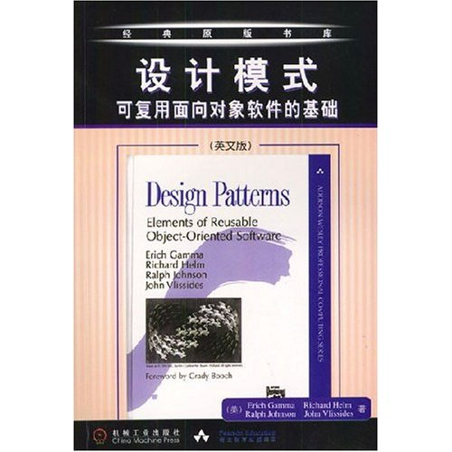

15.1 Introduction of Design Pattern
History
  Gang of Four(GoF): Erich Gamma; Richard Helm; Ralph Johnson; John Vlissides
  《Design Patterns: Elements of Reusable Object-Oriented Software》
      Includes 23 types of Design Patterns
  How to learn “Design Pattern”
    Based on these “proved successful” design, to learn how to “design”
Read, practice, think, repeatedly
GoF
Gamma, Erich, R. Helm, R. Johnson, and J. Vlissides. Design patterns: Elements of Reusable Object-Oriented Software. Addison-Wesley, 1995.
Elisabeth Freeman, Eric Freeman, Bert Bates, Kathy Sierra. Head First Design Patterns, O'Reilly Media, 2004.
Notes:
1995年，软件设计领域的四大顶级大师“四人帮”第一次将 设计模式上升到理论高度，并将之规范化。他们一共总结了23种设计模式。此后，在可复用的面向对象软件的发展中，新的设计模式不断涌现。

Slide 4
15.1 Introduction of Design Pattern
Three Principles for Design Pattern
  Interface-oriented Programming, not Implementation-oriented Programming
  Object combination, not inheritance, is preferred
  Encapsulate the change points to realize loose coupling
Essence: Implement the proposed design principles – OCP, ……

Slide 5
15.1 Essential elements of Design pattern
Pattern name is a handle we can use to describe a design problem, its solutions, and consequences in a word or two
Problem describes when to apply the pattern. It explains the problem and its context
Solution describes the elements that make up the design, their relationships, responsibilities, and collaborations
Consequences are the results and trade-offs of applying the pattern. Though consequences are often unvoiced when we describe design decisions, they are critical for evaluating design alternatives and for understanding the costs and benefits of applying the pattern

Slide 6
15.1 Catalog of design patterns
Creational Design Patterns
  Abstract Factory
  Builder
  Factory Method
  Prototype
  Singleton
Structural Design Patterns
  Adaptor
  Bridge
  Composite
  Decorator
  Façade
  Flyweight
  Proxy
Behavioral Design Patterns
  Chain of Responsibility
  Command
  Interpreter：
  Iterator
  Mediator
  Memento
  Observer
  State
  Strategy
  Template Method
  Visitor

Slide 7
15.2 Creational Design Patterns
Solve the problem of how to create the instance/object of class
Types of creational design patterns
Singleton
Factory Method
Abstract Factory
Builder
Prototype

Slide 8
15.2 Creational pattern — Singleton
Intent:
  Ensure a class only has one instance, and provide a global point of access to it.
Motivation:
  For some classes, it is important to have exactly one instance. For example, printer spooler, USA president
  Instance-controlled class
When to use?
  There must be exactly one instance of a class, and it must be accessible to clients from a well-known access point.
  When the sole instance should be extensible by subclassing, and clients should be able to use an extended instance without modifying their code
Notes:
美国总统的职位是Singleton，美国宪法规定了总统的选举，任期以及继任的顺序。这样，在任何时刻只能由一个现任的总统。无论现任总统的身份为何，其头衔"美利坚合众国总统"是访问这个职位的人的一个全局的访问点。

Slide 9
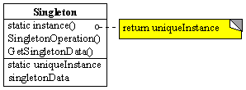
15.2 Creational pattern — Singleton
Singleton
  Defines an Instance operation that lets clients access its unique instance. Instance is a class operation (that is, a class method in Smalltalk and a static member function in C++).
  May be responsible for creating its own unique instance.
The client can access the instance of Singleton only by instance() operation.

Slide 10
Realization of Singleton
class Singleton
{
private static Singleton _instance;
private Singleton(){ }
public static Singleton f_Instance
{
get
{
if(_instance == null)
{
_instance = new Singleton();
}
return _instance;
}
}
}
Make the construction function Private
Private static attribute
Public static method
Notes:
核心是 构造函数 私有化
类中 定义 一个 静态私有变量和Static公有方法

Slide 11
15.2 Creational pattern — Singleton
Advantages
  Control access to sole instance.
  Reduce name space.
  Permit refinement of operations and representation.
  More flexible than class operations

Slide 12
15.2 Creational pattern — Singleton
Disadvantage of Using global/static object
  all the singleton must be created regardless of being used or not. → it can be avoided by using static member function
  Delete the object?? → No consideration
Question：What should be pay attention to when Singleton is used under multi-thread?
Static Singleton() //静态构造函数
{
_instance = new Singleton(); //私有构造器
}
Make the construction function Static!
Notes:
静态构造器保证了在多线程时只有一个线程执行，自动加锁。

Slide 13
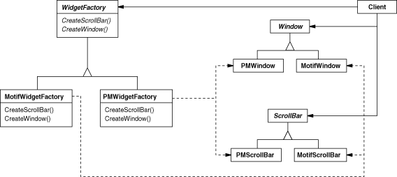
15.2 Creational pattern —Abstract factory
Intent：
  Provide an interface for creating families of related or dependent objects without specifying their concrete classes.
Motivation：JFC Swing Look & Feel
  Consider a user interface toolkit that supports multiple look-and-feel standards. Different look-and-feels define different appearances and behaviors for user interface "widgets" like scroll bars, windows, and buttons. To be portable across look-and-feel standards, an application should not hard-code its widgets for a particular look and feel. Instantiating look-and-feel-specific classes of widgets throughout the application makes it hard to change the look and feel later

Slide 14
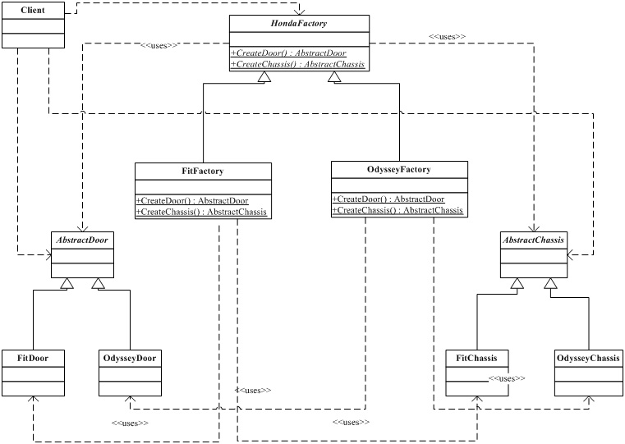
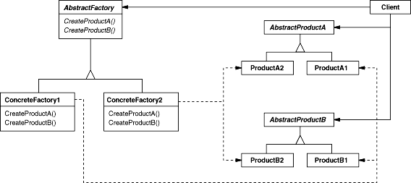
15.2 Creational pattern —Abstract factory
Defining an abstract Factory class that declares an interface for creating each basic kind of widget. There's also an abstract class for each kind of widget, and concrete subclasses implement widgets for specific look-and-feel standards. Factory's interface has an operation that returns a new widget object for each abstract widget class
AbstractFactory Declare the interface of the abstract object
ConcreteFactory Implement the operation
AbstractProduct Declare the interface for a product
ConcreteProduct Define the product object that will be created by the corresponding concrete factory
  Implement the interface of AbstractProduct
Client
  Only use the interface declared by AbstractFactory and AbstractProduct

Slide 15
A CASE – BMW CAR & BORA CAR
abstract class AbstractWheel // 抽象产品
{
public AbstractWheel()
{
Console.Write("Create a
AbstractProduct"); } }
abstract class AbstractOilBox
{ public AbstractOilBox()
{ } }
class BMWWheel:AbstractWheel // 具体的Product
{ public BMWWheel()
{
Console.Write("Create a BMWwheel");
} }
class BMWOilBox:AbstractOilBox
{ public BMWOilBox()
{
Console.Write(“Create a BMWOilBox”);
}
}
abstract class AbstractFactory // 抽象工厂
{
abstract public AbstractWheel CreatWheel();
abstract public AbstractOilBox CreatOilBox();
}
class BMWFactory: AbstractFactory // 具体的工厂
{
public override AbstractWheel CreatWheel()
{
return new BMWWheel();
}
public override AbstractOilBox CreatOilBox()
{
return new BMWOilBox();
}
}

Slide 16
A CASE – BMW CAR & BORA CAR
// TEST Program
static void Main(string[] args)
{
AbstractFactory factory = null;
factory = new BMWFactory();
factory.CreatWheel();
Console.Write("\n");
factory.CreatOilBox();
Console.Write("\n")
Console.Read();
}
Display：
Create a BMWwheel
Create a BMWOilBox
If a BORA CAR is needed? How to change it ?

Slide 17
15.2 Creational pattern —Abstract factory
Advantages:
Isolation of concrete classes
Exchanging Product Families easily
Promoting consistency among products
Disadvantages:
  Difficult to support new kind of products:
Notes:
Isolation of concrete classes:
The Abstract Factory pattern helps you control the classes of objects that an application creates. Because a factory encapsulates the responsibility and the process of creating product objects, it isolates clients from implementation classes. Clients manipulate instances through their abstract interfaces. Product class names are isolated in the implementation of the concrete factory; they do not appear in client code.
Exchanging Product Families easily:
The class of a concrete factory appears only once in an application, that is where it's instantiated. This makes it easy to change the concrete factory an application uses. It can use different product configurations simply by changing the concrete factory. Because an abstract factory creates a complete family of products, the whole product family changes at once.
Promoting consistency among products:
When product objects in a family are designed to work together, it's important that an application use objects from only one family at a time. AbstractFactory makes this easy to enforce.
Disadvantages of Abstract Factory:
Difficult to support new kind of products:
Extending abstract factories to produce new kinds of Products isn't easy. That's because the AbstractFactory interface fixes the set of products that can be created. Supporting new kinds of products requires extending the factory interface, which involves changing the AbstractFactory class and all of its subclasses. But you can overcome this problem by using reflection in .Net Framework and defining CreateProduct method in the AbstractFactory class
优点：
分离客户代码与具体的类
因为一个工厂封装创建产品对象的责任和过程，它将客户与类的实现分离，客户通过它们的抽象接口操纵实例。
产品的类名也在具体工厂的实现中被分离；它们不出现在客户代码中。
易于交换产品系列
一个具体工厂类在一个应用中仅出现一次——即在它初始化的时候。这使得改变一个应用的具体工厂变得很容易。
只需改变具体的工厂即可使用不同的产品配置，这是因为一个抽象工厂创建了一个完整的产品系列，所以整个产品系列会立刻改变。
它有利于产品的一致性
当一个系列中的产品对象被设计成一起工作时，一个应用只能同时使用同一系列中的对象，这一点很重要，而Abstract Factory很容易实现这一点。
缺点：
难以支持新种类的产品，难以扩展抽象工厂以生产新种类的产品。
因为Abstract Factory接口确定了可以被创建的产品集合。支持新种类的产品就需要扩展该工厂接口，这将涉及Abstract Factory类及其所有子类的改变。

Slide 18
15.2 Creational pattern —Abstract factory
When to use this pattern?
A system should be independent of how its products are created, composed, and represented
A system should be configured with one of multiple families of products
A family of related product objects is designed to be used together, and you need to enforce this constraint
You want to provide a class library of products, and you want to reveal just their interfaces, not their implementations
Notes:
肯德基
麦当劳

Slide 19
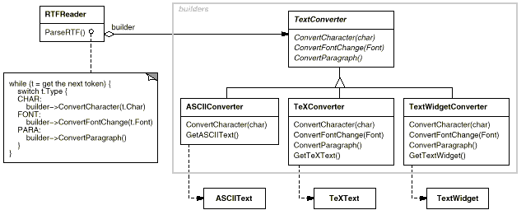
15.2 Creational pattern —Builder
Intent
  Separate the construction of a complex object from its representation so that the same construction process can create different representations
Motivation：
  To allow adding new constructed elements without modifying the class itself during the construction of complex objects.
  “Structure the construction process”

Slide 20
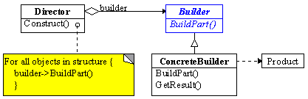
15.2 Creational pattern —Builder
Builder (TextConverter)
Specifies an abstract interface for creating parts of a Product object
ConcreteBuilder (ASCIIConverter, TeXConverter, TextWidgetConverter)
Constructs and assembles parts of the product by implementing the builder interface
Defines and keeps track of the representation it creates
Provides an interface for retrieving the product (e.g., GetASCIIText,
GetTextWidget)
Director (RTFReader)
Constructs an object using the Builder interface
Product (ASCIIText, TeXText, TextWidget)
Represents the complex object under construction. ConcreteBuilder builds the product's internal representation and defines the process by which it's assembled
Includes classes that define the constituent parts, including interfaces for assembling the parts into the final result

Slide 21
A CASE – Select BMW CAR & BORA CAR
The Common Method
public static void Main()
{
  Car car = new Car();
  Console.Write("Wheel:" + car._wheel + "\n");
  Console.Write("OilBox:" + car._oilBox + "\n");
  Console.Write("Body:" + car._body + "\n");
  Console.Read();
}
public class Car
{
  public string _wheel = “BMWWheel”;
  public string _oilbox = “BMWOilBox”;
  public string _body = “BMWBody”;
}

Slide 22
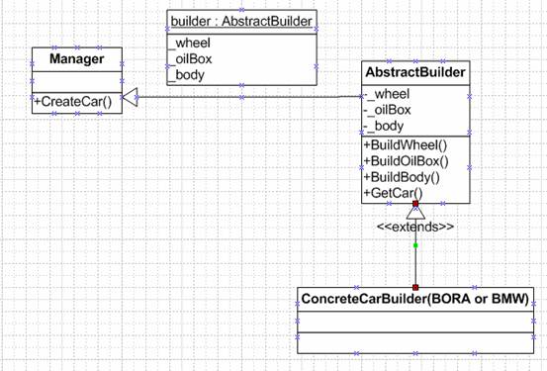
A CASE – Select BMW CAR & BORA CAR
AbstractBuilder抽象类
public abstract class AbstractBuilder
{
  public string _wheel;
  public string _oilBox;
  public string _body;
  public abstract void BuildWheel();
  public abstract void BuildOilBox();
  public abstract void BuildBody();
public abstract Car GetCar();
}
public abstract class Car
{ }

Slide 23
A CASE – Select BMW CAR & BORA CAR
BMW创建—最频繁变动部分：
public class BMWBuilder:AbstractBuilder
{ public BMWBuilder()
{ // TODO: 在此处添加构造函数逻辑 }
public override void BuildWheel()
{ _wheel = "BMWWheel"; }
public override void BuildOilBox()
{ _oilBox = "BMWOilBox"; }
public override void BuildBody()
{ _body = "BMWBody"; }
public override Car GetCar()
{ return new BMWCar(); }
}
public class BMWCar:Car
{ }
BORA创建—最频繁变动部分：
public class BORABuilder:AbstractBuilder
{ public BORABuilder()
{ // TODO: 在此处添加构造函数逻辑 }
override void BuildWheel()
{ _wheel = " BORAWheel"; }
public override void BuildOilBox()
{ _oilBox = " BORAOilBox"; }
public override void BuildBody()
{ _body = " BORABody"; }
public override Car GetCar()
{ return new BORACar(); }
}
public class BORACar:Car
{ }

Slide 24
A CASE – Select BMW CAR & BORA CAR
CAR的创建—Builder模式中提到的相对稳定的算法
private class CarManager
{
public BuilderClass.Car CreateCar(BuilderClass.AbstractBuilder builder)
{
  builder.BuildBody();
  builder.BuildOilBox();
  builder.BuildWheel();
  Console.Write("Wheel:" + builder._wheel + "\n");
  Console.Write("OilBox:" + builder._oilBox + "\n");
  Console.Write("Body:" + builder._body + "\n");
  Console.Read();
  return builder.GetCar();
}
}

Slide 25
A CASE – Select BMW CAR & BORA CAR
TEST
public static void Main()
{
  CarManager manager = new CarManager();
  BuilderClass.Car car =
  manager.CreateCar(new BuilderClass.BORABuilder());
}
结果如下：
Wheel:BORAWheel
OilBox:BORAOilBox

Slide 26
15.2 Creational pattern —Builder
When to use?
  The algorithm for creating a complex object should be independent of the parts that make up the object and how they're assembled
  The construction process must allow different representations for the object that's constructed

Slide 27
15.2 Creational pattern —Builder
Advantages
  Can change the internal representation of a product.
    The product is constructed by the abstracted interface. Only by defining a new constructer, can the internal representation be changed.
  Construction code is separated from representation code.
    The modularity of an object is improved by encapsulating the creation and representation mode.
  Can control the construction process more precisely.

Slide 28
15.2 Creational pattern — Factory Method
Static Factory Method, Simple Factory Method
Intent
Define an interface for creating an object, but let subclasses decide which class to instantiate
Factory Method lets a class defer instantiation to subclasses
Virtual Constructor
Motivation
Frameworks use abstract classes to define and maintain relationships between objects.
A framework is often responsible for creating these objects as well.
Notes:
在软件系统中，经常面临着“某个对象”的创建工作，由于需求的变化，这个对象的具体实现经常面临着剧烈的变化，但是它却拥有比较稳定的接口。如何应对这种变化？提供一种封装机制来隔离出“这个易变对象”的变化，从而保持系统中“其它依赖该对象的对象”不随着需求的改变而改变？这就是要说的Factory Method模式了。
意图
定义一个用户创建对象的接口，让子类决定实例化哪一个类。Factory Method使一个类的实例化延迟到其子

Slide 29
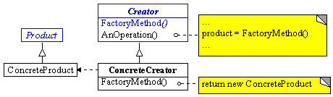
15.2 Creational pattern — Factory Method
Creator (工厂角色)
  Declare the methods of the factory, which returns an object of Product type. Creator can also be used to define a default implementation of a factory method to return a default ConcreteProduct object
  Can call factory method to create a Product object.
Product（抽象产品角色） Define the interface of the objects created by factory method
ConcreteProduct （具体产品角色） Realize the interface of Product
ConcreteCreator
  Re-define factory method to return a ConcreteProduct instance

Slide 30
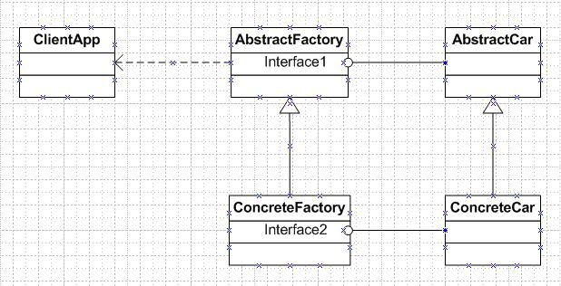
A CASE – Select BMW CAR & BORA CAR
Problem: ClientApp want a car object, thus need to call the Factory to construct the car, which is the subclass referred in << Design pattern>> and inherited from the base class AbstractFactory. It is this class Factory that determines which subclasses should be instantialized.
Define two base class firstly
public abstract class AbstractCar
{
public abstract string Run();
public abstract string Stop();
public abstract string Accelerate();
public abstract string Decelerate();
}
public abstract class AbstractFactory
{ //Factory类型的作用是构建Car的对象
public abstract AbstractCar CreateCar();
}

Slide 31
A CASE – Select BMW CAR & BORA CAR
public class BMWCar:AbstractCar
{
public override string Run() { return “BMW Run“; }
public override string Stop() { return “BMW Stop“; }
public override string Accelerate() {return “BMW Accelerate“;}
public override string Decelerate() {return "BMW Decalerate“;}
}
public class BMWFactory:AbstractFactory
{
public override AbstractCar CreateCar()
{ return new BMWCar(); }
}

Slide 32
A CASE – BMW CAR & BORA CAR
class Class1 {/// 应用程序的主入口点。
[STAThread]
static void Main(string[] args){
AbstractCar car = CreateCarFunc(new BMWFactory ());
Console.Write(car.Run() + "\n");
Console.Write(car.Stop() + "\n");
Console.Write(car.Accelerate() + "\n");
Console.Write(car.Decelerate() + "\n");
Console.Read(); }
public static AbstractCar CreateCarFunc(AbstractFactory factory)
{ return factory.CreateCar(); } }
在客户端程序中，我们AbstractFactory的对象来得到Car的对象, 结果如下：
BMW Run
BMW Stop
BMW Accelerate
BMW Decalerate
Question: How about for BORA CAR?

Slide 33
15.2 Creational pattern — Factory Method
Advantages:
  Client Code is not related with specific applications and thus can be applied to any entity class
  Base class can supply the default realization for factory method. The subclass can re-write the new implementation, or, inherit the implementation of the parent’s class.
  Make the class hierarchy much clearer —— Parallelization
Disadvantages:
  Concrete Creator and Creator are not necessary
When to use?
  A class can't anticipate the class of objects it must create
  Only know the parameters input into the factory, and don’t care about how to create the object
Notes:
Factory Method模式是设计模式中应用最为广泛的模式，通过本文，相信读者已经对它有了一定的认识。然而我们要明确的是：在面向对象的编程中，对象的创建工作非常简单，对象的创建时机却很重要。Factory Method要解决的就是对象的创建时机问题，它提供了一种扩展的策略，很好地符合了开放封闭原则

Slide 34
15.2 Creational pattern — Prototype
Intent:
  Specify the kinds of objects to create using a prototypical instance, and create new objects by copying this prototype.
Motivation:
  Using an existing object as the prototype, to create new objects. When adding the new objects, their detailed creation work is completed by themselves and thus the creation process of new objects is separated from the framework
The object model in Java language support prototype directly
java.lang.Object Origin class
protected Object clone();
java.lang.Cloneable Interface

Slide 35
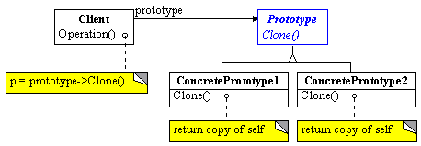
15.2 Creational pattern — Prototype
Prototype
  Declare an interface for cloning itself
ConcretePrototype
  Implement an operation to clone itself
Client
  Create a new object by asking a prototype to clone itself

Slide 36
15.2 Creational pattern — Prototype
When to use?
  When the classes to be instantiated are specified at run-time, for example, by dynamic loading;
  To avoid building a class hierarchy of factories that parallels the class hierarchy of products;
  When instances of a class can have one of only a few different combinations of state. It may be more convenient to install a corresponding number of prototypes and clone them rather than instantiating the class manually, each time with the appropriate state

Slide 37
15.2 Creational pattern — Prototype
Main Advantages:
  It hides the concrete product classes from the client, thereby reducing the number of names clients know about. Moreover, these patterns let a client work with application-specific classes without modification.
Other advantages:
  Adding and removing products at run-time
  Specifying new objects by varying values
  Specifying new objects by varying structure
  Reduced subclassing
  Configuring an application with classes dynamically
Disadvantages:
  each subclass of Prototype must implement the Clone operation, which may be difficult.

Slide 38
15.2 Creational pattern — Conclusion
Factory Method
  Essence: Completing creation process by using a virtual method.
Abstract Factory
  The factory method of a product forms the interface of a factory
Prototype
  Construct product by product prototype: Clone + prototype manager
Builder
  Separate the construction process and client by a construction algorithm and builder interface
Singleton
  Sole instance type. Control and limit the instanliazation by construction function, a static variable and a static method

Slide 39
15.2 Creational pattern — Conclusion
Factory Method, Abstract Factory, Prototype all involves the creation process of objects in class hierarchy
    Prototype needs Prototype Manager
    Factory Method needs a Creator class
    Abstract Factory need a parallel class hierarchy
Builder is suitable to apply for specific structure. The product is much complicated and needs to be created step by step
Singleton is physically meaningful. It can be used in many subtle places. It is not necessarily associated with class hierarchy
These patterns are commonly used. Sometimes two or more patterns should be combined to complete the modeling task
  Which pattern is used is based on the application requirements and the adopted modeling language

Slide 40
15.3 Structural Design Patterns
Describe how classes and objects are composed to form larger structures
  Structural class patterns: use inheritance to compose interfaces or implementations
  Structural object patterns: Describe ways to compose objects to realize new functionality. The added flexibility of object composition comes from the ability to change the composition at run-time, which is impossible with static class composition.

Slide 41
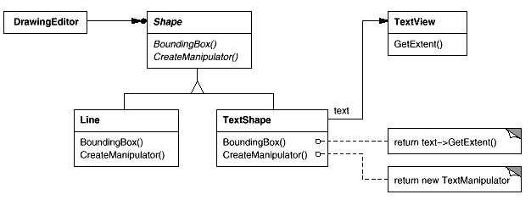
15.3 Structural Design Patterns—Adapter
Intent
  Convert the interface of a class into another interface clients expect. Adapter lets classes work together that couldn't otherwise because of incompatible Interfaces.
Motivation
  Sometimes a toolkit class that's designed for reuse isn't reusable only because its interface doesn't match the domain-specific interface an application requires.
target
adaptee
adapter

Slide 42
15.3 Structural Design Patterns—Adapter
When to use?
  You want to use an existing class, and its interface does not match the one you need
  You want to create a reusable class that cooperates with unrelated or unforeseen classes, that is, classes that don't necessarily have compatible interfaces
  (object adapter only) you need to use several existing subclasses, but it‘s impractical to adapt their interface by subclassing every one. An object adapter can adapt the interface of its parent class

Slide 43
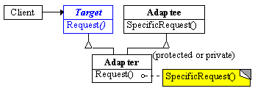
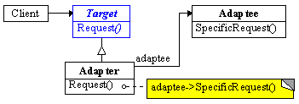
15.3 Structural Design Patterns—Adapter
Target
  Defines the domain-specific interface that Client uses.
Client
  Collaborates with objects conforming to the Target interface.
Adaptee
  Defines an existing interface that needs adapting.
Adapter
  Adapts the interface of Adaptee to the Target interface.
Class adaptor
Object adaptor
第 <number> 页

Slide 44
15.3 Structural Design Patterns—Adapter
Essentially, these are two reuse mode
  class adapter： → Realized by Inheritance
    Won't work when we want to adapt a class and all its subclasses.
    Let Adapter override some of Adaptee's behavior, since Adapter is a subclass of Adaptee
  object adapter → Realized by composition
  Lets a single Adapter work with many Adaptees—that is, the Adaptee itself and all of its subclasses (if any). The Adapter can also add functionality to all Adaptees at once.
  Harder to override Adaptee behavior. It will require subclassing Adaptee and making Adapter refer to the subclass rather than the Adaptee itself.
Matching precision of Adapter:
  The workload of Adapter is decided by the similarity degree of the interface of Target and that of Adaptee

Slide 45
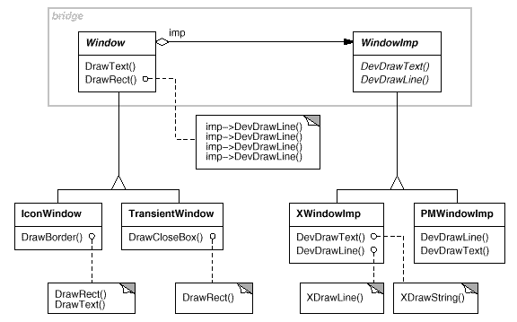
15.3 Structural Design Patterns— Bridge
Intent:
  Decouple an abstraction from its implementation so that the two can vary independently
    Common methods — Inheritance：Implementation class inherits the abstract class
    Disadvantages: not flexible enough –implementation is bounded with abstract permanently
Motivation
  There are changes about more than two directions.

Slide 46
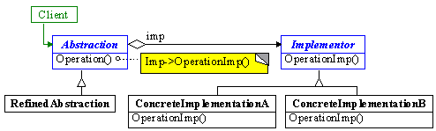
15.3 Structural Design Patterns— Bridge
Abstraction (Window)
  Defines the abstraction's interface.
  Maintains a reference to an object of type Implementor
RefinedAbstraction (IconWindow)
Extends the interface defined by Abstraction.
Implementor (WindowImp)
Defines the interface for implementation classes. This interface doesn't have to correspond exactly to Abstraction's interface; in fact the two interfaces can be quite different. Typically the Implementor interface provides only primitive operations, and Abstraction defines higher-level operations based on these primitives.
ConcreteImplementor (XWindowImp, PMWindowImp)
Implements the Implementor interface and defines its concrete implementation.

Slide 47
15.3 Structural Design Patterns— Bridge
Advantages
  Decoupling interface and implementation. Bound at run-time
  Improved extensibility. You can extend the Abstraction and Implementor hierarchies independently
  Hiding implementation details from clients

Slide 48
15.3 Structural Design Patterns— Bridge
When to use?
  You want to avoid a permanent binding between an abstraction and its implementation
  Both the abstractions and their implementations should be extensible by subclassing
  Changes in the implementation of an abstraction should have no impact on clients;
  (C++) You want to hide the implementation of an abstraction completely from clients.
  You have a proliferation of classes as shown earlier in the first Motivation diagram.

Slide 49
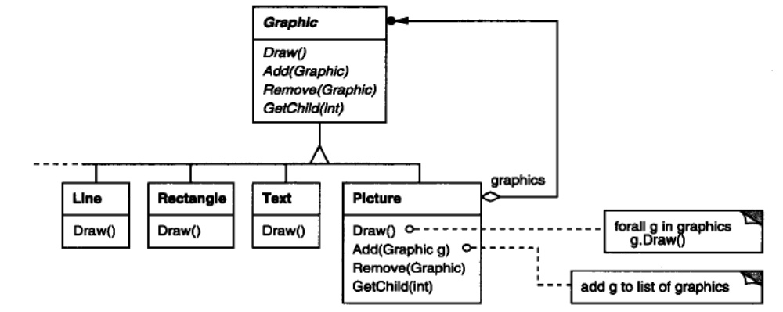
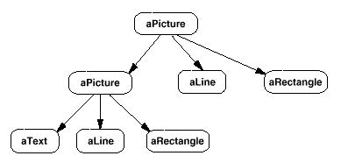
15.3 Structural Design Patterns— Composite
Intent
  Compose objects into tree structures to represent part-whole hierarchies. Composite lets clients treat individual objects and compositions of objects uniformly
Motivation:
  Group components to form larger components, which in turn can be grouped to form still larger components which are called as “(container)”
  There are the same interfaces for the container and single components, which include two parts: Function of single component and the function managing the sub-components.
  Recursive composition

Slide 50
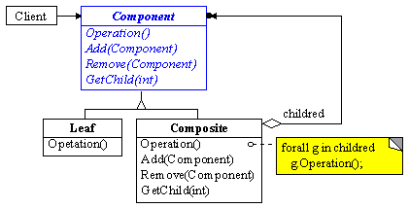
15.3 Structural Design Patterns— Composite
Component
  Declares the interface for objects in the composition
  Implements default behavior for the interface common to all classes, as appropriate
  Declares an interface for accessing and managing its child components
  (optional)Defines an interface for accessing a component's parent in the recursive structure, and implements it if that's appropriate
Leaf
  Represents leaf objects in the composition. A leaf has no children
  Defines behavior for primitive objects in the composition
Composite
  Defines behavior for components having children
  Stores child components
  Implements child-related operations in the Component interface
Client
  Manipulates objects in the composition through the Component interface

Slide 51
15.3 Structural Design Patterns— Composite
When to use?
  You want to represent part-whole hierarchies of objects.
  You want clients to be able to ignore the difference between compositions of objects and individual objects. Clients will treat all objects in the composite structure uniformly

Slide 52
15.3 Structural Design Patterns— Composite
Advantages:
  Defines class hierarchies consisting of primitive objects and composite objects
  Makes the client simple.
  Makes it easier to add new kinds of components.
  Can make your design overly general.

Slide 53
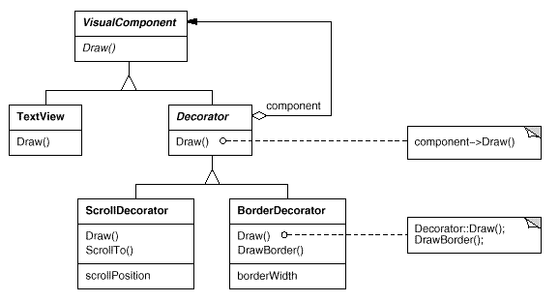
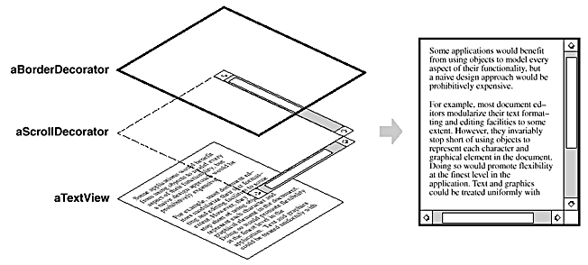
15.3 Structural Design Patterns—Decorator
Intent：
Attach additional responsibilities to an object dynamically. Decorators provide a flexible alternative to subclassing for extending functionality.
Motivation:
  Want to add responsibilities to individual objects, not to an entire class.

Slide 54
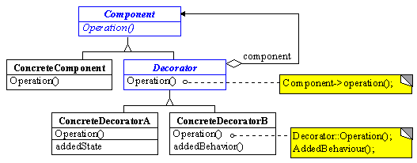
15.3 Structural Design Patterns—Decorator
Component (VisualComponent)
  Defines the interface for objects that can have responsibilities added to them dynamically
ConcreteComponent (TextView)
  Defines an object to which additional responsibilities can be attached
Decorator
  Maintains a reference to a Component object and defines an interface that conforms to Component's interface
ConcreteDecorator (BorderDecorator, ScrollDecorator)
  Adds responsibilities to the component
第 <number> 页

Slide 55
A case study：Extend GSM and Bluetooth for cell phone
// Define an interface for cellphone → 就是上图中的 component
public abstract class AbstractCellPhone
{
public abstract string CallNumber();
public abstract string SendMessage();
}
// Define Nokiacellphone → 就是上图中的 concrete component
public class NokiaPhone : AbstractCellPhone
{
public override string CallNumber()
{ return "NokiaPhone call sombody“; }
public override string SendMessage()
{ return "NokiaPhone send a
message to somebody“; } }
// Define MOTO cellphone → 就是上图中的 concrete component
public class MotoPhone : AbstractCellPhone
{
public override string CallNumber()
{ return “MotoPhone call sombody“; }
public override string SendMessage()
{ return “MotoPhone send a
message to somebody“; } }

Slide 56
A case study：Extend GSM and Bluetooth for cell phone
// Define Decorator Interface
public abstract class Decorator: AbstractCellPhone
{
AbstractCellPhone _phone;
public Decorator(AbstractCellPhone phone)
{ _phone = phone; }
public override string CallNumber()
{ return _phone.CallNumber(); }
public override string SendMessage()
{ return _phone.SendMessage(); }
}

Slide 57
public class DecoratorGPS : Decorator
{ public DecoratorGPS(AbstractCellPhone phone)
: base(phone) { }
public override string CallNumber()
{ return base.CallNumber() + " with GPS“; }
public override string SendMessage()
{ return base.SendMessage() + " with GPS“; } }
public class DecoratorBluetooth : Decorator
{ public DecoratorBluetooth(AbstractCellPhone phone)
: base(phone) { }
public override string CallNumber()
{ return base.CallNumber() + " with Bluetooth“; }
public override string SendMessage()
{ return base.SendMessage() + " with Bluetooth“; } }

Slide 58
static void Main(string[] args)
{
AbstractCellPhone phone = new NokiaPhone();
Console.WriteLine(phone.CallNumber());
Console.WriteLine(phone.SendMessage());
DecoratorGPS gps = new DecoratorGPS(phone); //add GSP
Console.WriteLine(gps.CallNumber());
Console.WriteLine(gps.SendMessage());
DecoratorBlueTooth bluetooth = new DecoratorBlueTooth(gps); //add GSP and bluetooth
Console.WriteLine(bluetooth.CallNumber());
Console.WriteLine(bluetooth.SendMessage());
Console.Read();
}
Results：
NokiaPhone call sombody
NokiaPhone send a message to somebody
NokiaPhone call sombody with GPS
NokiaPhone send a message to somebody with GPS
NokiaPhone call sombody with GPS with BlueTooth
NokiaPhone send a message to somebody with GPS with BlueTooth

Slide 59
15.3 Structural Design Patterns—Decorator
When to use?
  To add responsibilities to individual objects dynamically and transparently, that is, without affecting other objects
  For responsibilities that can be withdrawn
  When extension by subclassing is impractical.
    Sometimes a large number of independent extensions are possible and would produce an explosion of subclasses to support every combination.
    Or a class definition may be hidden or otherwise unavailable for subclassing

Slide 60
15.3 Structural Design Patterns—Decorator
Advantages:
  More flexibility than static inheritance.
  Avoids feature-laden classes high up in the hierarchy.
Disadvantages:
  A decorator and its component aren't identical
  Lots of little objects

Slide 61
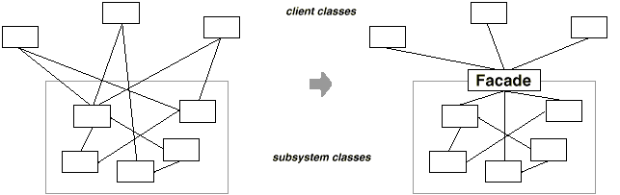
15.3 Structural Design Patterns— Facade
Intent:
  Provide a unified interface to a set of interfaces in a subsystem.
  Defines a higher-level interface that makes the subsystem easier to use.
Motivation
  To minimize the communication and dependencies between subsystems.
  To introduce a facade object that provides a single, simplified interface to the more general facilities of a subsystem.

Slide 62
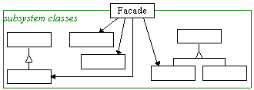
15.3 Structural Design Patterns— Facade
Participants
  Façade
  subsystem classes (Scanner, Parser, ProgramNode, etc.)

Slide 63
A Case Study: A car with a body, four wheels and an engine
internal class Engine
{ public string EngineWork()
{ return "BMW's Engine is Working“; }
public string EngineStop()
return "BMW's Engine is stopped“; }
}
internal class Wheel
{ public string WheelCircumrotate()
{
return "BMW's Wheel is
Circumrotating“; }
public string WheelStop()
return "BMW's Wheel is stoped";
}
}
internal class Body
{ public Wheel[] wheels = new Wheel[4];
public Engine engine = new Engine();
public Body()
{
for (int i = 0; i < wheels.Length; i++)
{ wheels[i] = new Wheel(); }
}
}
定义三个子系统：
Engine
Wheel
Body

Slide 64
A Case Study: A car with a body, four wheels and an engine
class CarFacade // Define 汽车的Facade
{
Body body = new Body();
public void Run()
{
Console.WriteLine(body.engine.EngineWork());
for(int i = 0; i < body.wheels.Length; i++)
{
Console.WriteLine(body.wheels[i].WheelCircumrotate());
} }
public void Stop()
{
Console.WriteLine(body.engine.EngineStop());
for (int i = 0; i < body.wheels.Length; i++)
{
Console.WriteLine(body.wheels[i].WheelStop());
}
} }

Slide 65
A Case Study: A car with a body, four wheels and an engine
class Program /// TEST Program
{
static void Main(string[] args)
{
CarFacade car = new CarFacade();
car.Run();
car.Stop();
Console.Read();
}
}
执行结果如下；
BMW's Engine is Working
BMW's Wheel is Circumrotating
BMW's Wheel is Circumrotating
BMW's Wheel is Circumrotating
BMW's Wheel is Circumrotating
BMW's Engine is stoped
BMW's Wheel is stoped
BMW's Wheel is stoped
BMW's Wheel is stoped
BMW‘s Wheel is stoped

Slide 66
15.3 Structural Design Patterns— Facade
When to use:
  you want to provide a simple interface to a complex subsystem.
  there are many dependencies between clients and the implementation classes of an abstraction
  You want to layer your subsystems. Use a facade to define an entry point to each subsystem level.

Slide 67
15.3 Structural Design Patterns— Facade
Advantages:
  It shields clients from subsystem components
  promotes weak coupling between the subsystem and its clients.
      Key technology for implement component software
  It doesn't prevent applications from using subsystem classes if they need to. Thus you can choose between ease of use and generality.

Slide 68
15.3 Structural Design Patterns—Flyweight
Intent:
  Use sharing to support large numbers of fine-grained objects efficiently.
Motivation:
  Fine granularities consume lots of memory and may incur unacceptable run-time overhead
  A flyweight is a shared object that can be used in multiple contexts simultaneously. The flyweight acts as an independent object in each context—it's indistinguishable from an instance of the object that's not shared. Flyweights cannot make assumptions about the context in which they operate

Slide 69
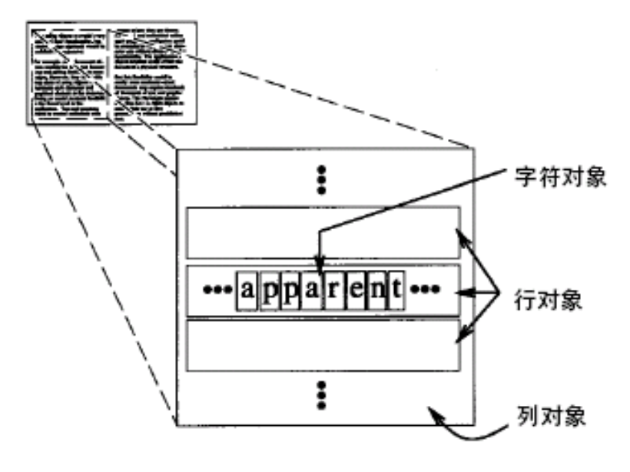
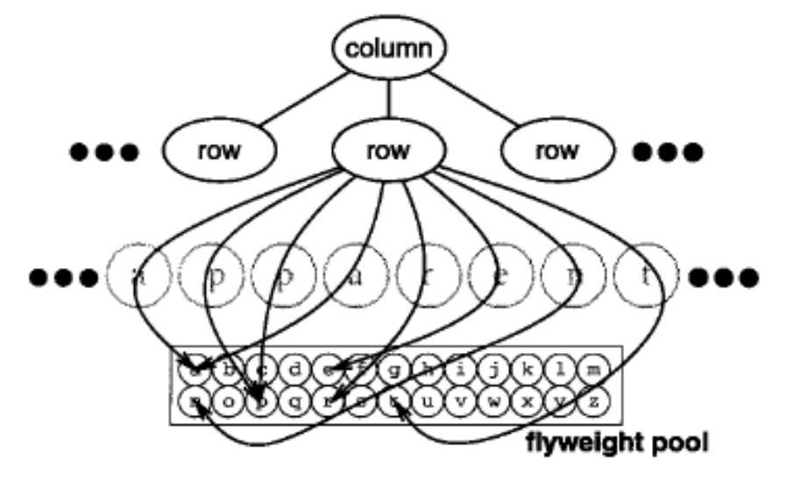
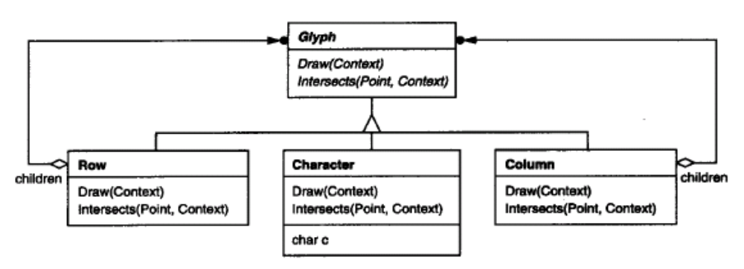
15.3 Structural Design Patterns—Flyweight
External state
Flyweight object

Slide 70
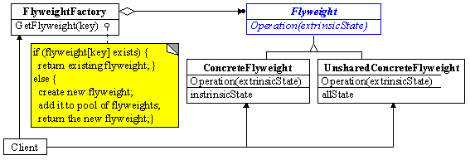
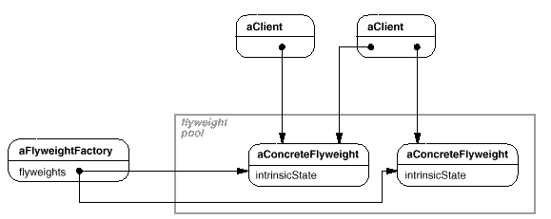
15.3 Structural Design Patterns—Flyweight

Slide 71
15.3 Structural Design Patterns—Flyweight
Flyweight
  Declares an interface through which flyweights can receive and act on extrinsic state
ConcreteFlyweight (Character)
Implements the Flyweight interface and adds storage for intrinsic state, if any. A ConcreteFlyweight object must be sharable. Any state it stores must be intrinsic; that is, it must be independent of the ConcreteFlyweight object's context
UnsharedConcreteFlyweight (Row, Column)
Not all Flyweight subclasses need to be shared. The Flyweight interface enables sharing; it doesn't enforce it. It's common for UnsharedConcreteFlyweight objects to have ConcreteFlyweight objects as children at some level in the flyweight object structure (as the Row and Column classes have)

Slide 72
15.3 Structural Design Patterns—Flyweight
FlyweightFactory
creates and manages flyweight objects
ensures that flyweights are shared properly. When a client requests a flyweight, the FlyweightFactory object supplies an existing instance or creates one, if none exists
Client
Maintains a reference to flyweight(s).
Computes or stores the extrinsic state of flyweight(s)

Slide 73
15.3 Structural Design Patterns—Flyweight
When to use?
An application uses a large number of objects
Storage costs are high because of the sheer quantity of objects
Most object state can be made extrinsic
Many groups of objects may be replaced by relatively few shared objects once extrinsic state is removed
The application doesn't depend on object identity. Since flyweight objects may be shared, identity tests will return true for conceptually distinct objects

Slide 74
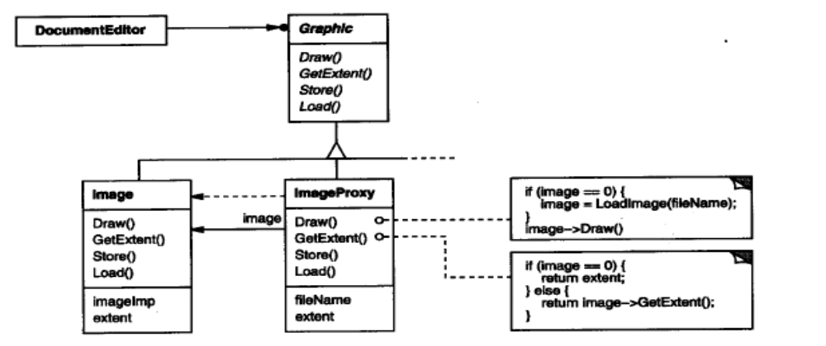
15.3 Structural Design Patterns—Proxy
Intent:
  Provide a surrogate or placeholder for another object to control access to it.
Motivation:
  Defer the full cost of the creation and initialization of an expensive object until we actually need to use it

Slide 75
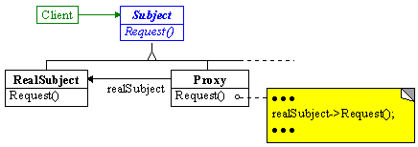
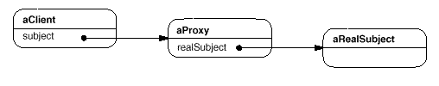
15.3 Structural Design Patterns—Proxy
Not change subject title, Not let the client feel the existence of proxy
Before/After Request is sent, specific operations can be executed, not just send request
Designate the client call to real subject

Slide 76
15.3 Structural Design Patterns—Proxy
Proxy (ImageProxy)
  Maintains a reference that lets the proxy access the real subject. Proxy may refer to a Subject if the RealSubject and Subject interfaces are the same
Subject (Graphic)
  Defines the common interface for RealSubject and Proxy so that a Proxy can be used anywhere a RealSubject is expected.
RealSubject (Image)
  Defines the real object that the proxy represents

Slide 77
15.3 Structural Design Patterns—Proxy
When to use?
  A remote proxy provides a local representative for an object in a different address space
  A virtual proxy creates expensive objects on demand. The ImageProxy described in the Motivation is an example of such a proxy
  A protection proxy controls access to the original object
  A smart reference is a replacement for a bare pointer that performs additional actions when an object is accessed

Slide 78
15.3 Structural Design Patterns—Conclusion
Adapter, Bridge, Facade
  Adapter is used for solving incompatibilities between two existing interfaces.
  Bridge is used to bridge an abstraction and its (potentially numerous) implementations.
  Facade is used to define a new simple easy-use interface for complex sub-systems
Composite, Decorator, Proxy
  Composite focuses on structuring classes so that many related objects can be treated uniformly, and multiple objects can be treated as one. Its focus is noton embellishment but on representation
  Decorator is designed to let you add responsibilities to objects without subclassing.
  Proxy composes an object and provides an identical interface to clients
Flyweight
  A method for globally control of fine-grained objects.

Slide 79
15.4 Behavioral Design Pattern
Behavioral patterns are concerned with algorithms and the assignment of responsibilities between objects.
Behavioral patterns describe not just patterns of objects or classes but also the patterns of communication between them.
  Behavioral class patterns use inheritance to distribute behavior between classes
    Template Method
    Interpreter
  Behavioral object patterns use object composition rather than inheritance

Slide 80
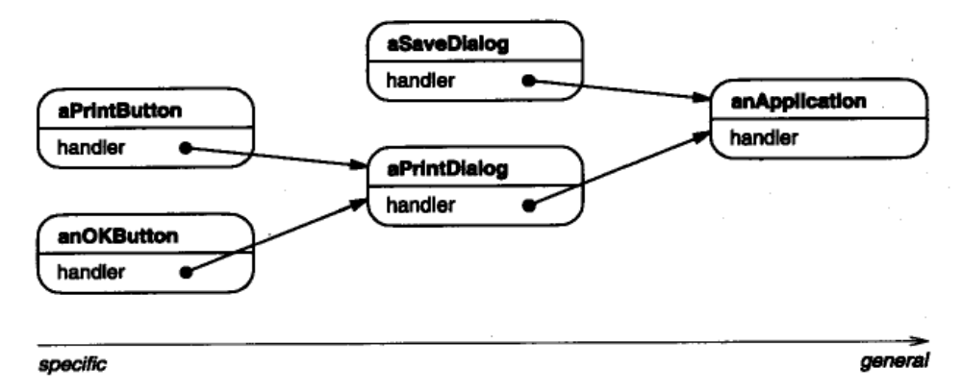
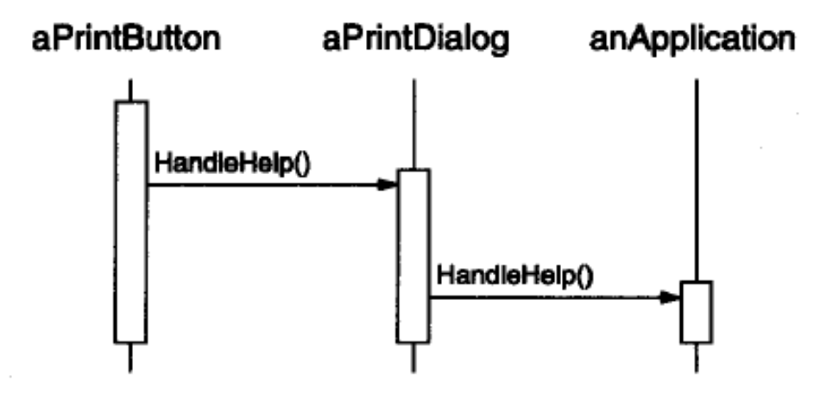
15.4 Behavioral Design Pattern —— Chain of Responsibility
Intent
  Avoid coupling the sender of a request to its receiver by giving more than one object a chance to handle the request. Chain the receiving objects and pass the request along the chain until an object handles it.
Motivation
  Organize help information according to its generality—from the most specific to the most general
  to decouple senders and receivers by giving multiple objects a chance to handle a request. The request gets passed along a chain of objects until one of them handles it

Slide 81
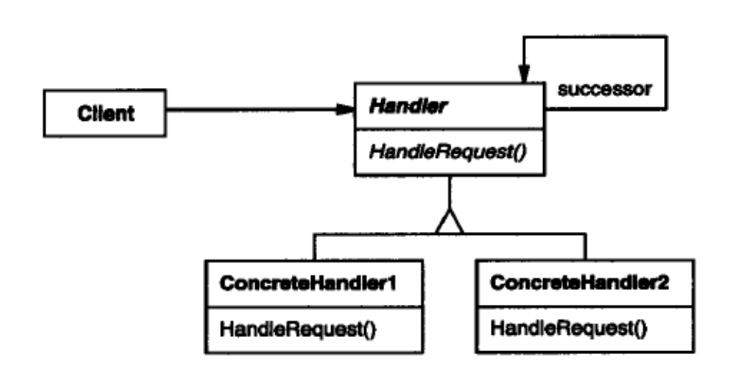
15.4 Behavioral Design Pattern —— Chain of Responsibility
Handler (HelpHandler)
Defines an interface for handling requests
(optional) Implements the successor link
ConcreteHandler (PrintButton, PrintDialog)
Handles requests it is responsible for.
Can access its successor.
If the ConcreteHandler can handle the request, it does so; otherwise it forwards the request to its successor
Client
Initiates the request to a ConcreteHandler object on the chain

Slide 82
15.4 Behavioral Design Pattern —— Chain of Responsibility
When to use?
More than one object may handle a request, and the handler isn't known a priori. The handler should be ascertained automatically
You want to issue a request to one of several objects without specifying the receiver explicitly
The set of objects that can handle a request should be specified dynamically

Slide 83
15.4 Behavioral Design Pattern —— Chain of Responsibility
Advantages:
  Reduced coupling. An object only has to know that a request will be handled "appropriately." Both the receiver and the sender have no explicit knowledge of each other, and an object in the chain doesn't have to know about the chain's structure
  Added flexibility in assigning responsibilities to objects
Disadvantages:
  Receipt isn’t guaranteed

Slide 84
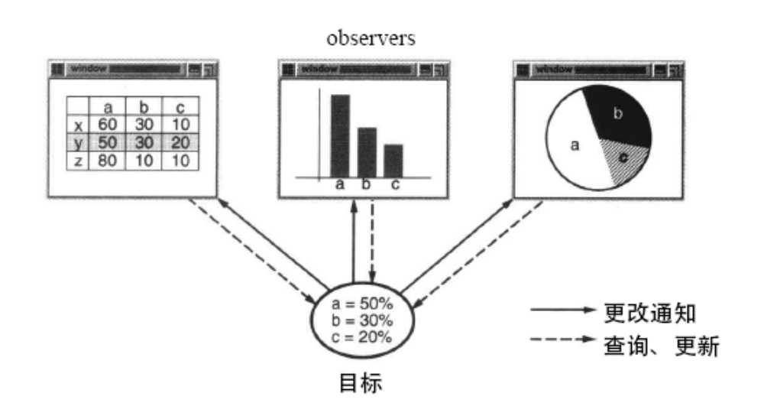
15.4 Behavioral Design Pattern—Observer
Publish/Subscribe， Model/ View， Source/Listener， Dependents
Intent
  Define a one-to-many dependency between objects so that when one object changes state, all its dependents are notified and updated automatically
Motivation
A common side-effect of partitioning a system into a collection of cooperating classes is the need to maintain consistency between related objects. You don't want to achieve consistency by making the classes tightly coupled, because that reduces their reusability.
The Observer pattern describes how to establish these relationships. The key objects in this pattern are subject and observer. A subject may have any number of dependent observers. All observers are notified whenever the subject undergoes change in state. In response, each observer will query the subject to synchronize its state with the subject's state.

Slide 85
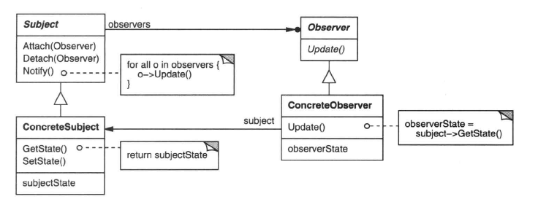
15.4 Behavioral Design Pattern—Observer
Subject
Knows its observers. Any number of Observer objects may observe a subject.
Provides an interface for attaching and detaching Observer objects.
Observer
Defines an updating interface for objects that should be notified of changes in a subject.
Concrete Subject
Stores state of interest to Concrete Observer objects.
Sends a notification to its observers when its state changes.
Concrete Observer
Maintains a reference to a Concrete Subject object.
Stores state that should stay consistent with the subject's.
Implements the Observer updating interface to keep its state consistent with the subject‘s

Slide 86
15.4 Behavioral Design Pattern—Observer
When to use?
When an abstraction has two aspects, one dependent on the other. Encapsulating these aspects in separate objects lets you vary and reuse them independently.
When a change to one object requires changing others, and you don't know how many objects need to be changed.
When an object should be able to notify other objects without making assumptions about who these objects are. In other words, you don't want these objects tightly coupled.

Slide 87
15.4 Behavioral Design Pattern—Observer
Advantages:
  Abstract coupling between Subject and Observer. All a subject knows is that it has a list of observers, each conforming to the simple interface of the abstract Observer class. The subject doesn't know the concrete class of any observer. Thus the coupling between subjects and observers is abstract and minimal
  Support for broadcast communication.
Disadvantages:
  Unexpected updates. Because observers have no knowledge of each other's presence, they can be blind to the ultimate cost of changing the subject.

Slide 88
Exercise 2
Requirements:
  Select an problem in the course project, and use one of more design patterns to solve the problem
  Draw the class diagram and give the implementation code
  Give the reason of using the design patterns
Hand-in:
  An explanatory document (of pdf/doc type) which includes the problem description and class diagram
  A package of source code
Email to me —ysliu@cad.zju.edu.cn / htl@zju.edu.cn
  Email title —— UML-2-Name-ID
  Deadline —— 2014.1.20 23:59:59

Slide 89
A useful trade
Is
a mine of gold

